Slide 1


Introduction to AI and ML
Welcome to the world of Artificial Intelligence (AI) and Machine Learning (ML). These transformative technologies are reshaping the world around us, from our daily interactions to groundbreaking scientific discoveries.
by Roshan Sabat

Slide 2

What is Artificial Intelligence?
AI refers to the ability of machines to exhibit human-like intelligence. This includes tasks like problem-solving, learning, and decision-making.
Types of AI
Applications
AI can be classified into narrow AI, general AI, and super AI, each with distinct capabilities and limitations.
AI is applied in numerous fields, including healthcare, finance, transportation, and entertainment.
Impact
AI is transforming industries, creating new opportunities, and raising ethical considerations.

Slide 3

Machine Learning Fundamentals
Machine learning is a subfield of AI that focuses on enabling computers to learn from data without explicit programming.
1
Data Collection
Gathering relevant data is crucial for training ML models. Data can be structured, unstructured, or semi-structured.
2
Model Training
ML models are trained on large datasets to identify patterns and relationships, leading to improved accuracy over time.
3
Model Evaluation
Once trained, models are evaluated on unseen data to measure their performance and identify areas for improvement.
4
Model Deployment
Deployed models are used to make predictions or decisions based on new input data, providing real-world value.

Slide 4

Supervised Learning Algorithms
Supervised learning involves training models on labeled data, where each input example has a corresponding output label.
1
Regression
2
Classification
Predicting continuous values, such as predicting housing prices based on location and size.
Categorizing data into discrete classes, such as identifying spam emails or classifying images of animals.
3
Decision Trees
4
Support Vector Machines (SVMs)
Tree-like structures that represent a series of decisions leading to a classification or prediction.
Finding the optimal hyperplane that separates data points into different classes.

Slide 5
Unsupervised Learning Algorithms
Unsupervised learning deals with unlabeled data, allowing models to discover hidden patterns and relationships.
Clustering
Dimensionality Reduction
Association Rule Mining
Grouping similar data points together based on their features, such as customer segmentation or image recognition.
Reducing the number of features in a dataset while preserving important information, useful for data visualization and model training.
Discovering relationships between items in a dataset, such as finding frequent item sets in retail transactions.

Slide 6
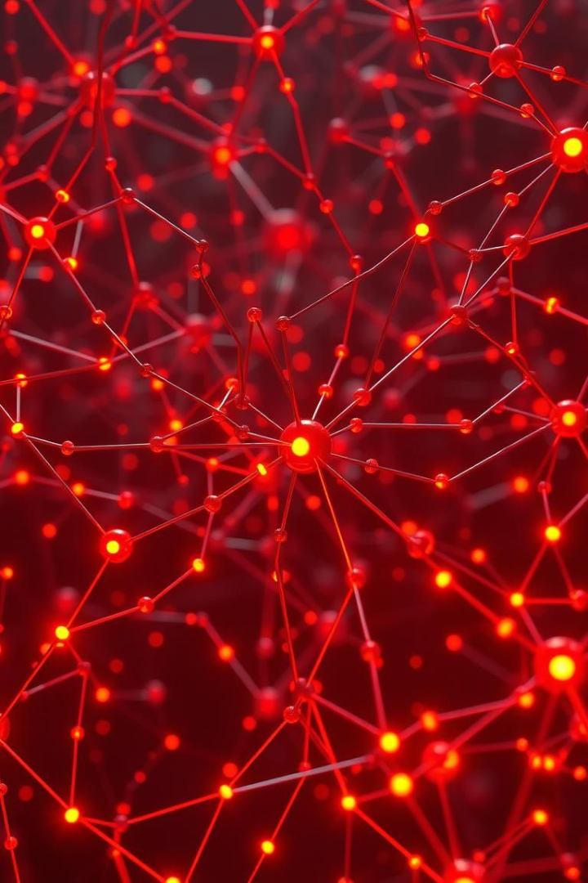



Deep Learning and Neural Networks
Deep learning is a subset of ML that utilizes artificial neural networks with multiple layers to learn complex representations from data.
Artificial Neural Networks
Inspired by the structure and function of the human brain, they consist of interconnected nodes that process information.
Convolutional Neural Networks (CNNs)
Designed for image and video processing, CNNs utilize convolutional filters to extract features from images.
Recurrent Neural Networks (RNNs)
Suitable for sequential data, RNNs use internal memory to process data in order, such as natural language processing.

Slide 7

Real-World Applications of AI and ML
AI and ML are transforming industries and improving our lives in countless ways.
Healthcare
Medical diagnosis, drug discovery, personalized treatment plans
Finance
Fraud detection, risk assessment, algorithmic trading
Transportation
Self-driving cars, traffic optimization, logistics management
Retail
Personalized recommendations, inventory management, customer service chatbots

Slide 8


The Future of AI and ML
AI and ML are rapidly evolving, with exciting possibilities for the future.
Automation
Cognitive Enhancement
Global Impact
Ethical Considerations
AI will continue to automate tasks, freeing up human time and resources for more creative endeavors.
AI can assist with cognitive tasks, improving decision-making, problem-solving, and learning.
AI has the potential to address global challenges, such as climate change, poverty, and disease.
Responsible development and deployment of AI are crucial to mitigate potential risks and ensure fairness.

